Slide 1

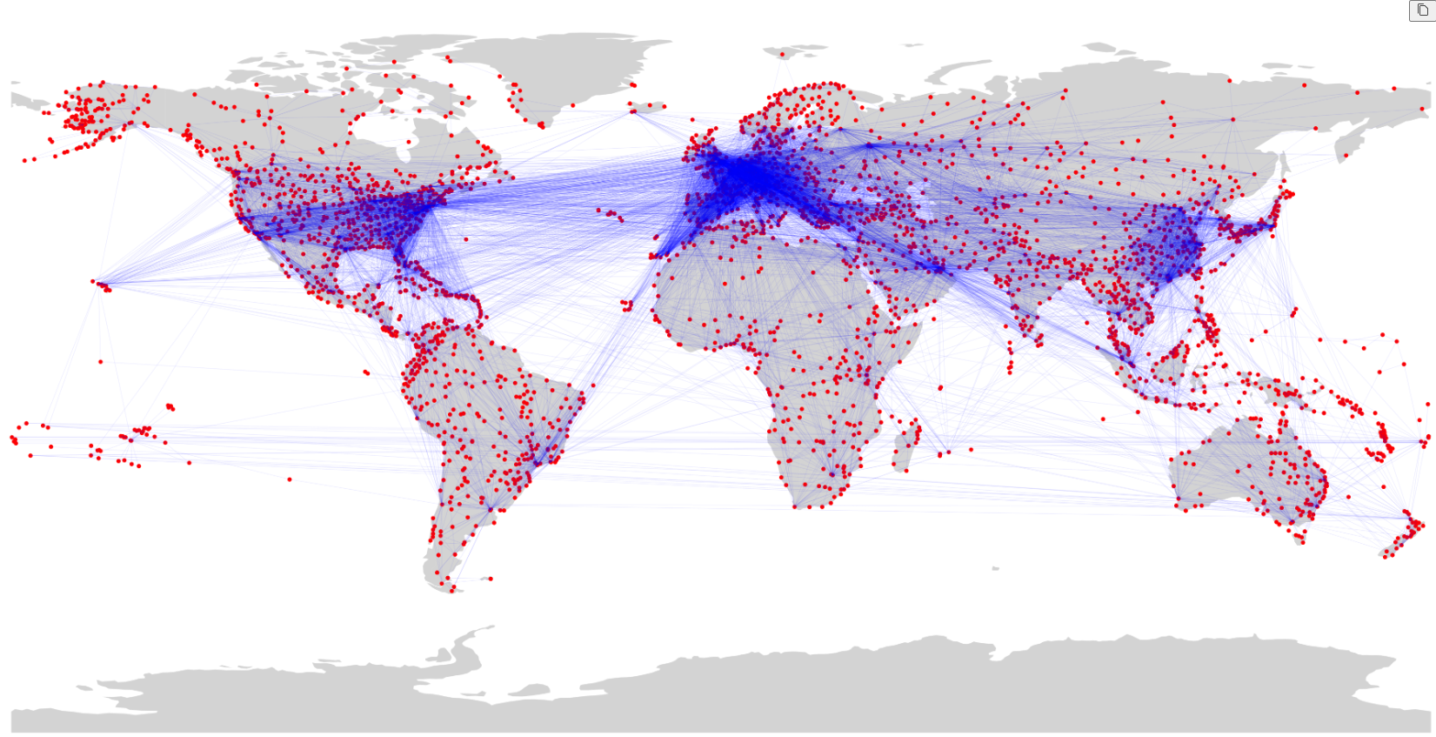
Hub Identification in Global Flight Network
Please use slideshow for the presentation.
Lab 14 Open Ended Lab
Group Members:
Muhammad Hamza (407251)
Aqsa Batool (413777)
Ahmed Mohiuddin Shah (415216)
Global Flight Network

Slide 2
Global Flight Network
Used Random Forest to predict closeness and betweenness centralities.
Hub Identification in Global Flight Network
Our Approach
Lab 14 Open Ended Lab
Group Members:
Muhammad Hamza (407251)
Aqsa Batool (413777)
Ahmed Mohiuddin Shah (415216)

Slide 3
Our Approach
Closeness Centrality:
R² = 0.85, MSE = 0.00034
Betweenness Centrality:
R² = 0.69, MSE = 0.000009
Cross Validation Scores:
Closeness Centrality:
Mean = 0.76
Betweenness Centrality:
Mean = 0.58
Global Flight Network
Key Metrics
Used Random Forest to predict closeness and betweenness centralities.

Slide 4
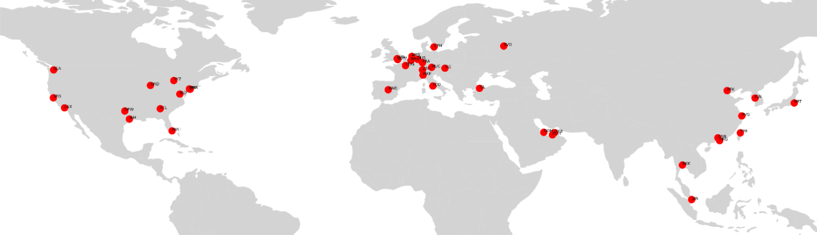
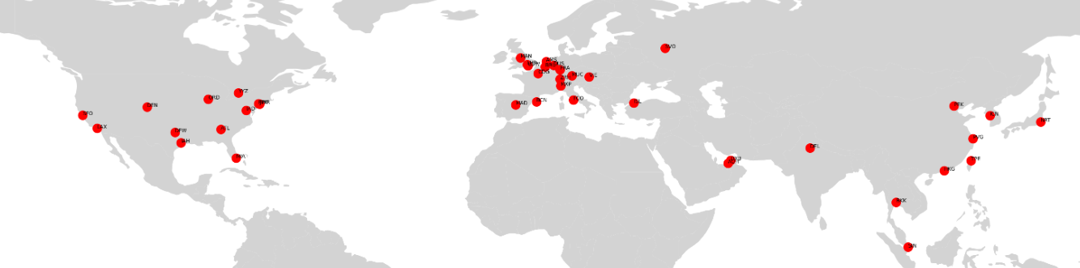
Key Metrics
Closeness Centrality:
R² = 0.85, MSE = 0.00034
Betweenness Centrality:
R² = 0.69, MSE = 0.000009
Cross Validation Scores:
Closeness Centrality:
Mean = 0.76
Betweenness Centrality:
Mean = 0.58
Our Approach
Used Random Forest to predict closeness and betweenness centralities.
Closeness Predicted
Closeness Real

Slide 5
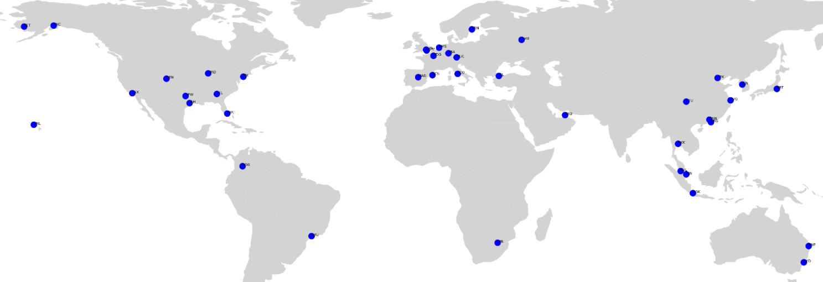
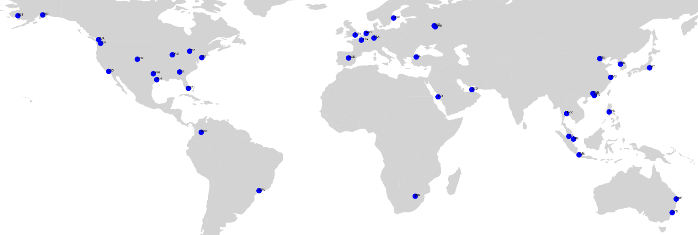
Key Metrics
Closeness Predicted
Closeness Centrality:
R² = 0.85, MSE = 0.00034
Betweenness Centrality:
R² = 0.69, MSE = 0.000009
Cross Validation Scores:
Closeness Centrality:
Mean = 0.76
Betweenness Centrality:
Mean = 0.58
Closeness Real
Betweenness Predicted
Betweenness Real

Slide 6
Key Insights
Closeness and Betweenness centralities effectively predict hubs.
Closeness Predicted
Closeness Real
Betweenness Predicted
Betweenness Real

Slide 7
Key Insights
Identifying Critical hubs and communities around the world and plan airports construction and expansion.
Closeness and Betweenness centralities effectively predict hubs.
Applications

Slide 8
Applications
Identifying Critical hubs and communities around the world and plan airports construction and expansion.
Key Insights
Closeness and Betweenness centralities effectively predict hubs.

